Slide 1

WIPRO NGA Program – Connectivity NMS Java Developer Batch
Capstone Project Presentation – 14th Aug 2024
Project Title Here – Device Discovery and Inventory Microservices
Presented by – Shubham Dhage (Lead)
Tharunkumar Tenepalli
Vijitha vellala
Sunkari Karteek
Shivani Kadam
Sudhakar Gurrampati
Veluru Bindu
www.rpsconsulting.in

Slide 2

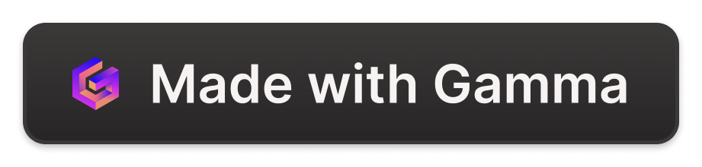
Device Discovery and Inventory Microservice
The Device Discovery and Inventory Microservice is an innovative solution designed to automate the identification and cataloging of network devices within an organization's IT infrastructure.
This project, developed as Capstone Project by our team, aims to streamline device management and provide valuable insights for enhanced network visibility and optimization.

Slide 3
Tools and Technology Used :-
Spring Boot - Used to Develop Java-Based Application.
GNS3 – Used to get running server so we get available Connected Devices
MySql – Used to store all Connected Devices.
Postman – Used for Testing Microservices(endspoints).

Slide 4
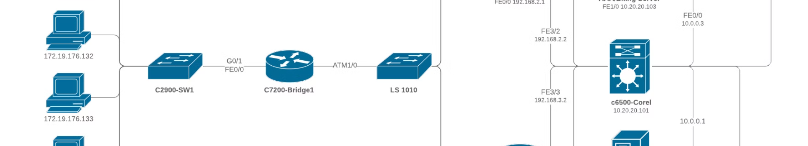
Overview of the Project
1
Automated Device Identification
2
Comprehensive Inventory
3
Scalable Architecture
The microservice is designed with a scalable and efficient architecture, allowing it to seamlessly handle the growing number of devices in modern IT environments.
The microservice utilizes advanced algorithms to automatically detect and classify a wide range of network devices, including routers, switches, servers, and IoT sensors.
The solution maintains a detailed and up-to-date inventory of all discovered devices, including their specifications, location, and connectivity information.

Slide 5

The microservice is capable of intelligently discovering and categorizing a wide range of network devices, including routers, switches, and access points.
It utilizes a combination of active and passive scanning techniques to continuously monitor the network for new devices and updates to existing ones, ensuring a comprehensive and up-to-date inventory.
With its user-friendly interface and robust reporting capabilities, the microservice empowers IT administrators to make informed decisions and proactively address any network equipment issues.

Slide 6
Key Features and Functionalities
Discovery and Identification
Inventory Management
Integration and Reporting
Comprehensive cataloging of device details, including specifications, location, and connectivity information, for improved network visibility.
Seamless integration with existing IT infrastructure and robust reporting capabilities for data-driven decision-making.
Advanced device detection algorithms that can identify a wide range of network devices, including routers, switches, servers, and IoT sensors.

Slide 7


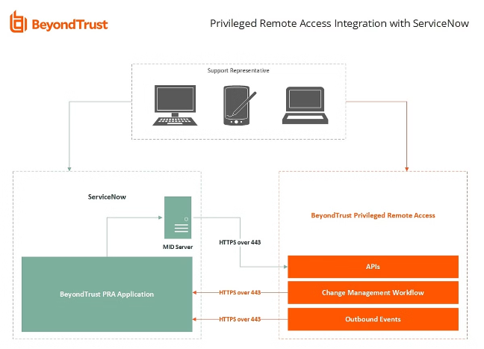


Integration with Existing IT Infrastructure
Discovery
The microservice actively scans the network to detect and identify connected devices.
Inventory
Detailed device information is cataloged and stored in a centralized database.
Integration
The solution seamlessly integrates with existing IT management tools and systems.

Slide 8

Future Enhancements and Roadmap
Predictive Maintenance
Automated Remediation
Leveraging machine learning and data analytics to predict device failures and proactively schedule maintenance, reducing downtime and improving operational efficiency.
Implementing intelligent algorithms to automatically detect and resolve network issues, ensuring optimal device performance and reducing the burden on IT teams.
Edge Computing Integration
Ongoing Enhancements
Integrating the microservice with edge computing devices to enable real-time device monitoring and decision-making at the network edge.
Continuously improving the microservice's capabilities, incorporating user feedback and adapting to the evolving IT landscape.

Slide 9

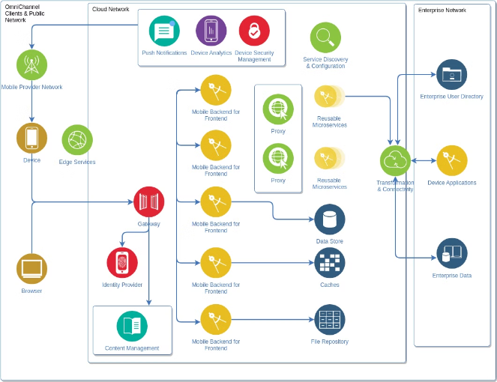
Scalable and Efficient Microservice Architecture
1
Modular Design
The microservice is built with a modular architecture, allowing for easy scalability and adaptability to changing IT requirements.
2
Distributed Processing
The solution leverages a distributed processing approach to handle the growing number of devices and data, ensuring efficient and high-performance operations.
3
Resilient and Fault-Tolerant
The microservice architecture is designed to be resilient and fault-tolerant, providing reliable and uninterrupted service even in the face of system failures or high-load scenarios.

Slide 10
Understanding SNMP and ICMP

Slide 11
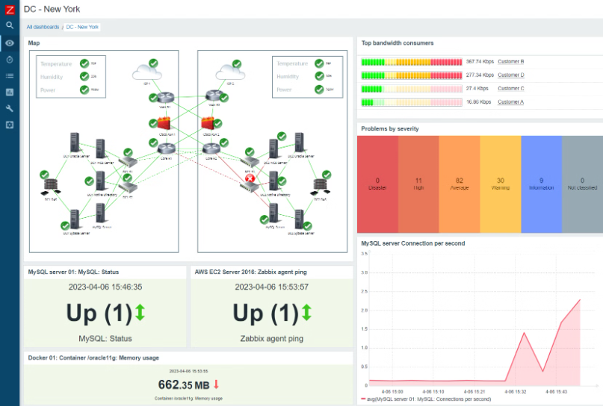
Simple Network Management Protocol (SNMP) is a protocol used for network management and monitoring.
Internet Control Message Protocol (ICMP) is a protocol used for error messages and network diagnostics.
When used together, SNMP and ICMP provide a complete solution for monitoring and managing network devices and diagnosing network issues.

Slide 12
What is SNMP?
SNMP collects, organizes, and sends data from various devices for network monitoring assisting with fault identification and isolation.
Both the monitored endpoints and the monitoring system rely on SNMP for seamless communication

Slide 13
Diagnostic Tools: ICMP is commonly used in diagnostic tools like ping and traceroute.
What Is ICMP?
ICMP, or Internet Control Message Protocol, is a core protocol in the Internet Protocol (IP) suite.
It's primarily used for sending control messages and error reports related to the operation of network communication.
ICMP is used to communicate errors and operational information about network issues.

Slide 14
Why do you need SNMP and ICMP monitoring tools?
Automatically discover, monitor, and manage network devices.
Monitor key performance metrics at the device and interface levels.
Obtain complete, granular visibility into network device performance.
Configure threshold limits and generate alerts in case of anomalies.

Slide 15
SNMP Vs ICMP:
While ICMP provides network diagnostics and error messages, SNMP focuses on network management and monitoring.
SNMP allows for the collection and analysis of network performance data and device configuration information, while ICMP is primarily used for troubleshooting network issues.
While both protocols are important for effective network management, they serve different purposes.

Slide 16
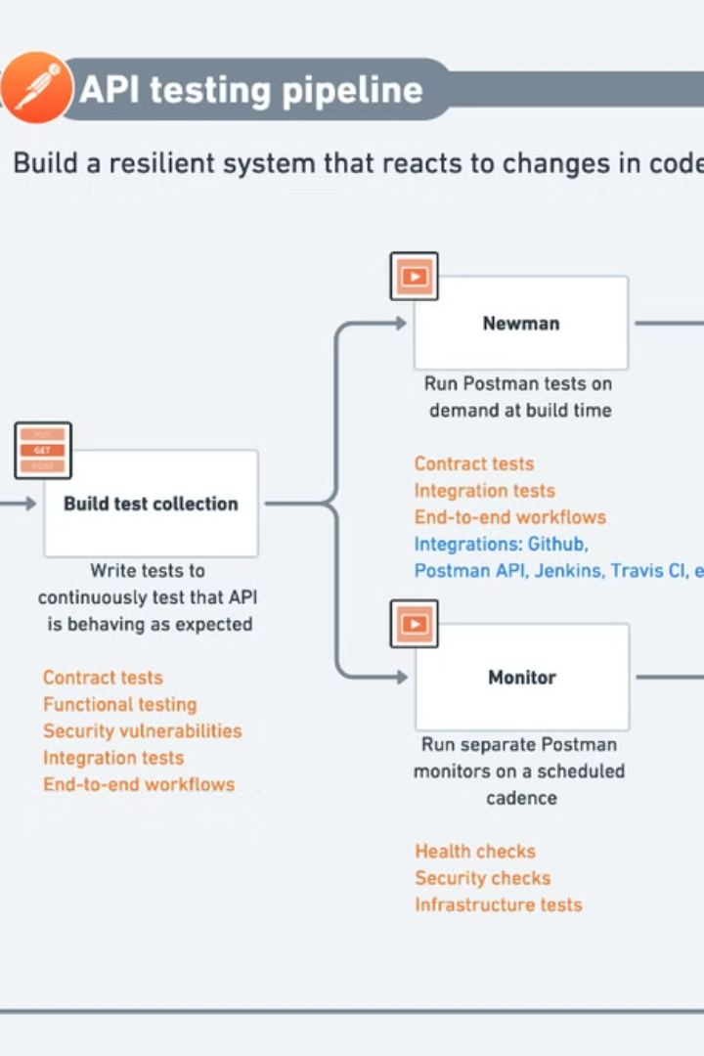
Introduction to Postman
Postman is a popular tool used for API testing and development.
It provides a user-friendly interface that allows developers to make HTTP requests, inspect responses, and automate testing workflows.
With Postman, you can easily send requests to APIs, analyze the responses, and collaborate with team members to ensure the smooth functioning of your applications.

Slide 17
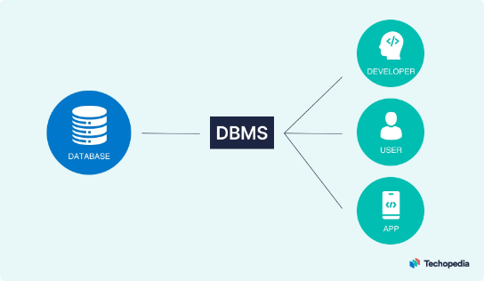
Leveraging a Robust MySQL Database
The microservice utilizes a MySQL database to store a comprehensive device inventory.
This includes detailed information such as device ID, name, IP address, status, and type.
The MySQL database provides a reliable and scalable solution for data storage and retrieval, enabling efficient management of the device inventory.
Its support for various database operations, including querying, updating, and deleting records, makes it a versatile and adaptable choice for this application.
This allows the microservice to maintain a robust and up-to-date inventory, ensuring IT administrators have the information they need to make informed decisions and address any network equipment issues that may arise.

Slide 18




Java Application Database Connection using GNS3
Architect the Solution
Design a robust, scalable database architecture to support the Java application. Leverage GNS3 to model the network infrastructure and test connectivity.
Establish Secure Connectivity
Implement secure protocols like SSL/TLS to encrypt data in transit between the Java app and the database. Configure firewall rules in GNS3 to control access.
Optimize Database Performance
Tune database settings and indexes to ensure efficient data retrieval and processing within the Java application. Monitor performance using GNS3 network traffic analysis.
Implement Failover and Redundancy
Set up a highly available database cluster with failover mechanisms. Use GNS3 to simulate network failures and validate the resilience of the solution.

Slide 19

GNS3 Connection Network
Explore how to leverage the powerful network simulation tool, GNS3, to model and test the connectivity between your Java application and the robust MySQL database powering your device inventory microservice.

Slide 20
What is GNS3 and GNS3-Server
GNS3 (Graphical Network Simulator-3) is a network simulation tool that allows users to design, configure, and test complex network topologies virtually.
It provides a graphical interface for creating network diagrams and simulating network devices, including routers, switches, and firewalls.
GNS3 Server is a component of GNS3 that handles the backend processes. It manages the actual simulation of network devices and communication between them.
The server runs the network simulations and interacts with the virtual devices, while the GNS3 client (the graphical interface) lets users design and interact with the network topology.
In summary, GNS3 is the overall application that provides the user interface and tools for network simulation, while GNS3 Server is the backend that performs the actual network emulation tasks

Slide 21
Setting Up the GNS3 Server:
The GNS3 server is configured to run on localhost with port 3080. A virtual network topology is created within GNS3 with various devices. Developing the Java Application:
GNS3 Client: This module sends HTTP requests to the GNS3 API to fetch the list of active projects and devices. Device Inventory Management: Once devices are discovered, their details are stored in the MySQL database. SNMP Integration: For each discovered device, additional information is fetched using SNMP queries.

Slide 22
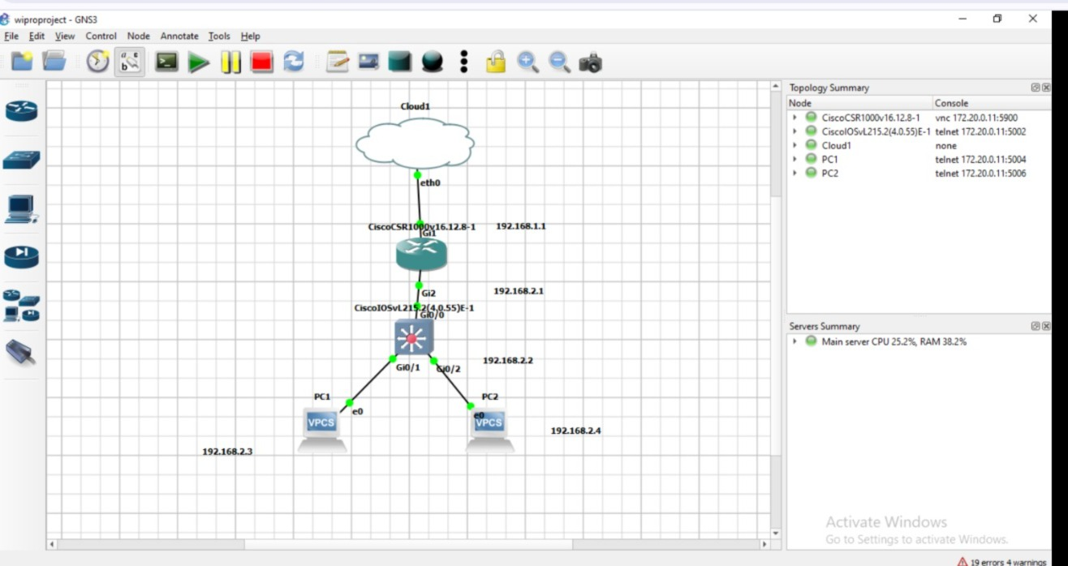

Slide 23
Running and Testing the Application
The Java application has been successfully deployed and connected to the GNS3 server. It now dynamically fetches and displays the list of devices in real-time. Any changes made to the GNS3 network topology, such as adding or removing devices, are automatically reflected in the Java application's device inventory.

Slide 24
Project Challenges:
API Integration Ensure seamless integration and reliable communication between the Java application and the GNS3 API, enabling efficient data exchange and real-time synchronization.
Dynamic Updates Implement a robust system to promptly reflect any changes in the network topology, keeping the device inventory up-to-date and accurate.
Scalability Design a scalable solution capable of handling large network deployments with potentially hundreds of devices, ensuring the application can meet the needs of enterprise-level environments.

Slide 25
Results and Benefits
Time Efficiency: The microservice significantly reduces the time required for network discovery and inventory management, enabling IT teams to work more efficiently.
Accuracy: The automated device detection process eliminates the human errors associated with manual network device discovery, ensuring a comprehensive and precise inventory.
Real-time Monitoring: The microservice provides up-to-date information about network devices, enhancing overall network reliability and security by allowing proactive identification and resolution of issues.

Slide 26
Future Work
Advanced Monitoring
1
Implement real-time monitoring and alerting capabilities to proactively detect and address any changes in device status across the network.
2
Extended Device Management
Develop a robust remote configuration and management system to allow IT administrators to directly control and optimize network devices from the Java application.
Scalable Architecture
3
Enhance the microservice's architecture to seamlessly handle the growing demands of enterprise-level networks, ensuring high performance and reliability at scale.

Slide 27

Conclusion
This project demonstrates the power of automation in enhancing network management tasks, particularly in virtualized environments like GNS3. The Java application provides a scalable and efficient solution for discovering and managing network devices, laying the groundwork for more advanced network management tools.

